Slide 1
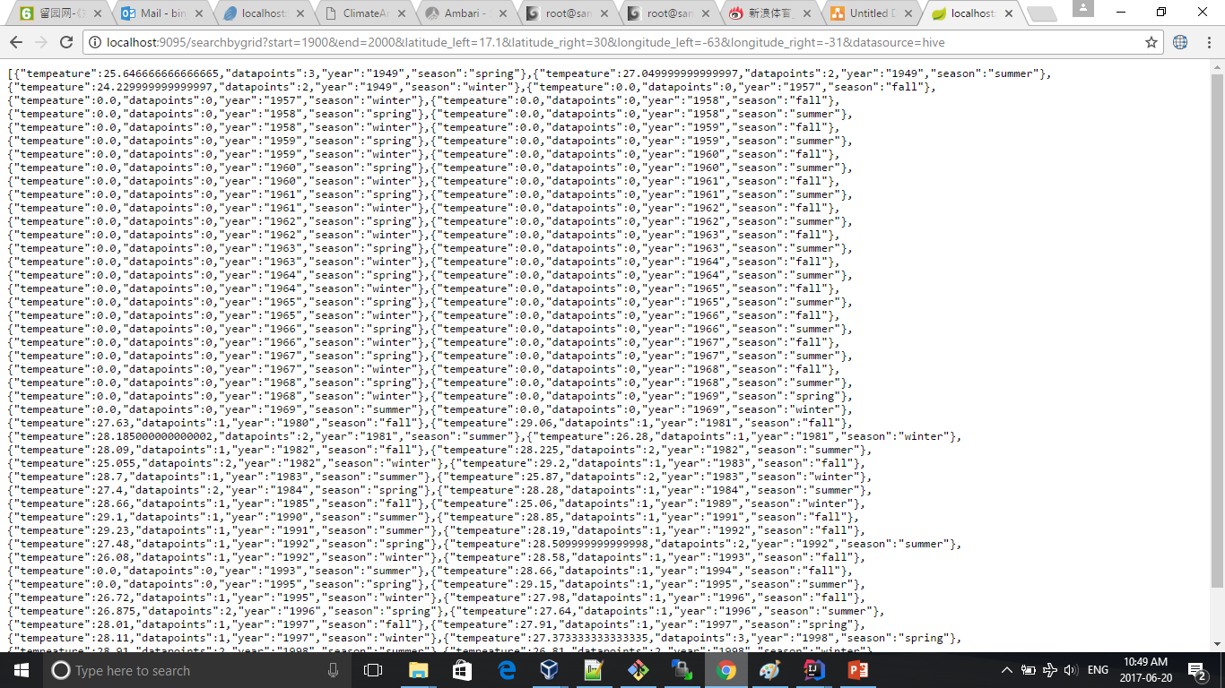
Bonus 2 – Hive Solution

Slide 2
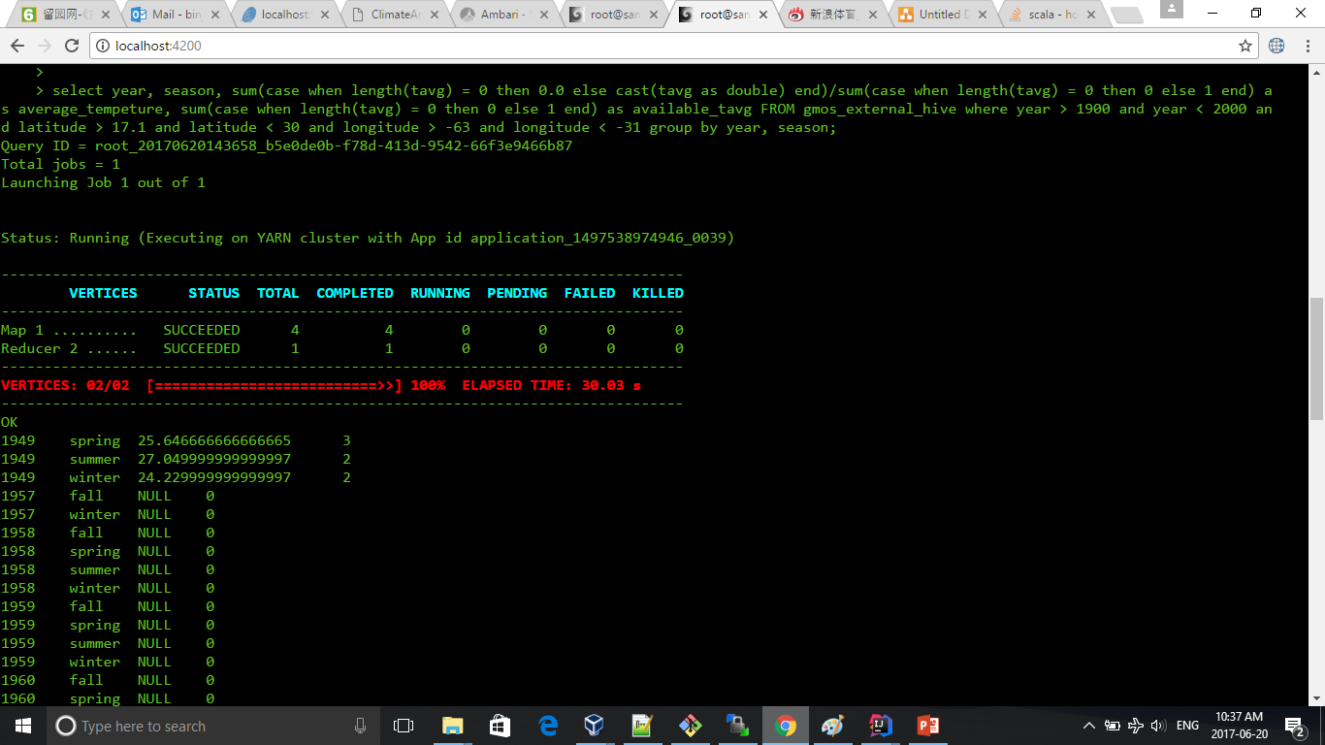
Bonus 2 – Hive Solution

Slide 3
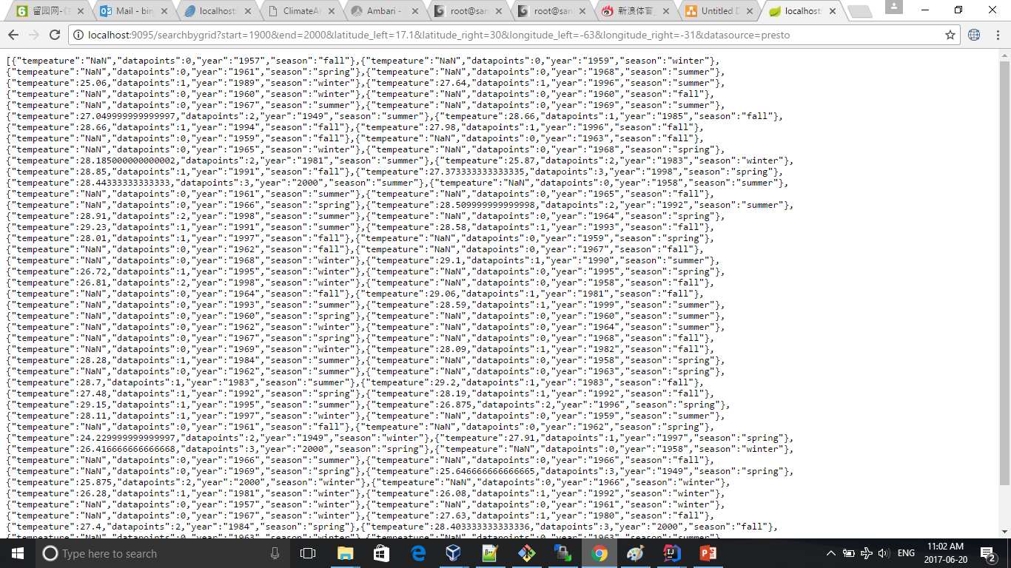
Bonus 2 – Presto Solution

Slide 4
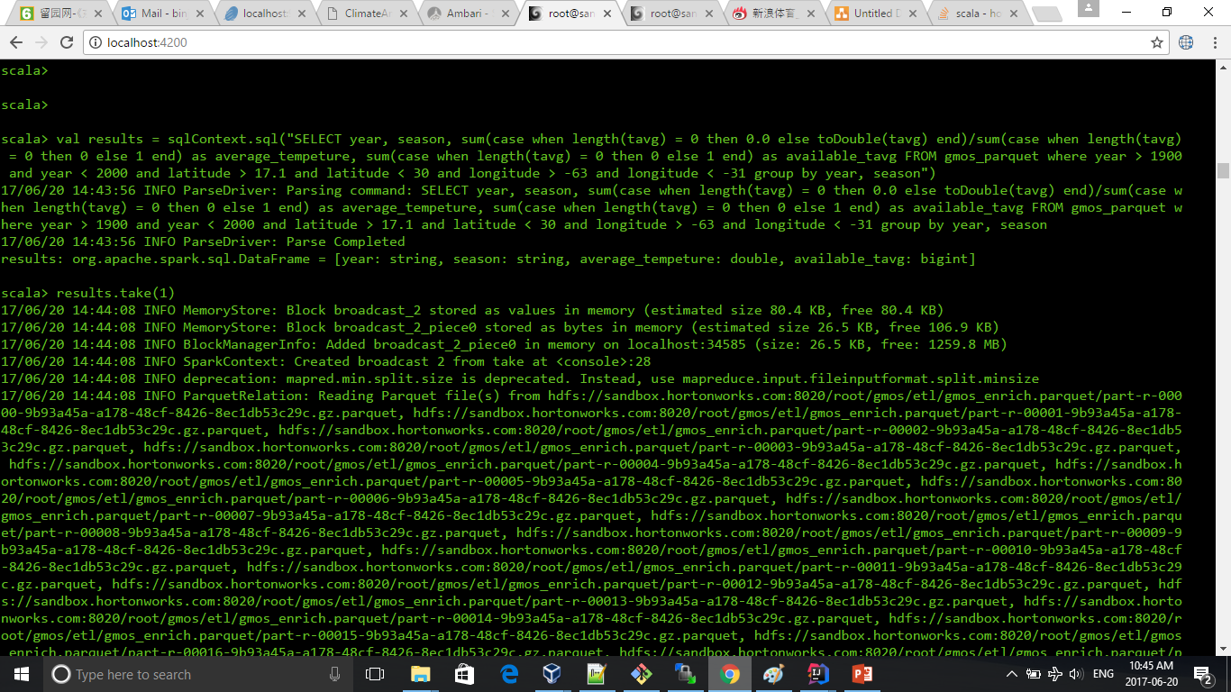
Bonus 2 – Spark Solution

Slide 5
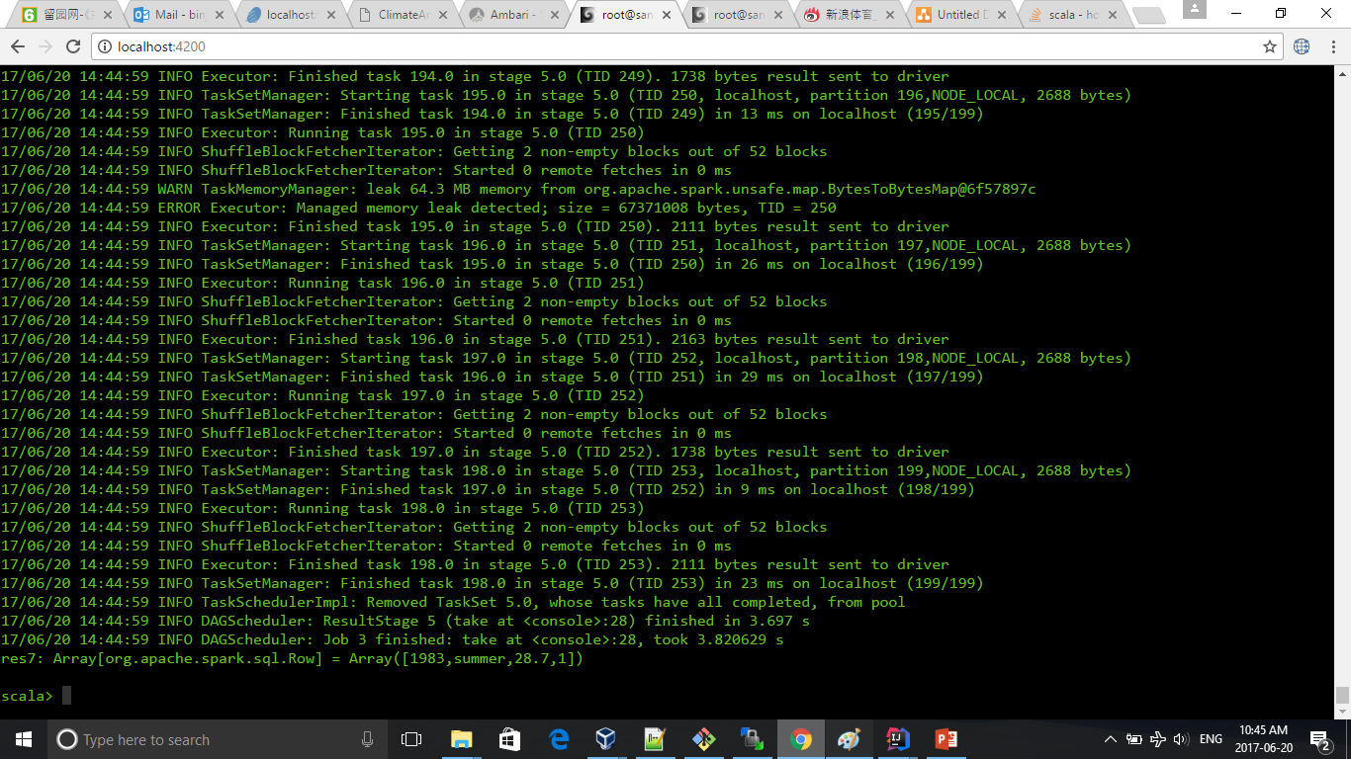
Bonus 2 – Spark Solution

Slide 6
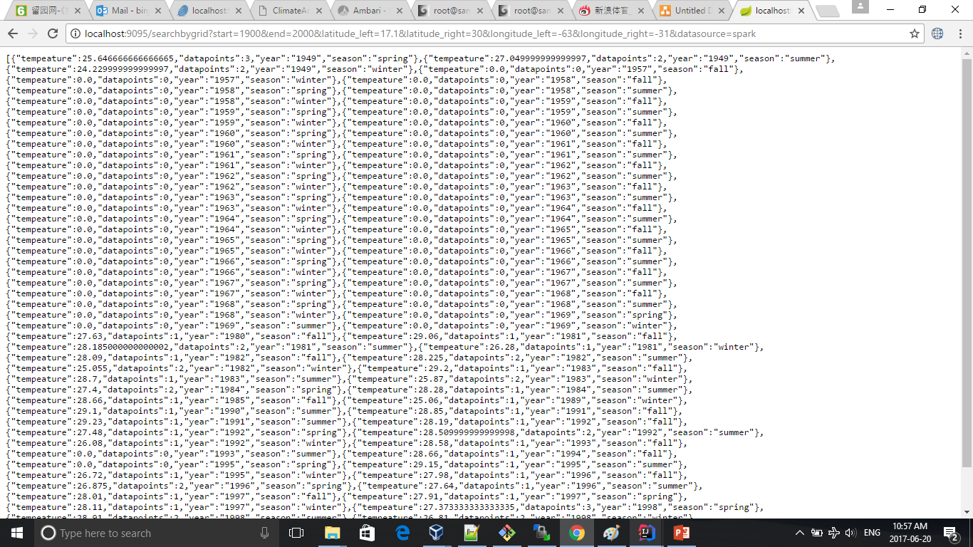
Bonus 2 – Spark Solution

